Slide 1
Software Development tooling: Git
Seth Russell – seth.Russell@cuanschutz.edu
AccordS Data Science Program, D2V Analytics Core
https://github.com/magic-lantern/bios6642-2021
Notes:
Introductions:
Names
programming experience
Statistics or research experience

Slide 2

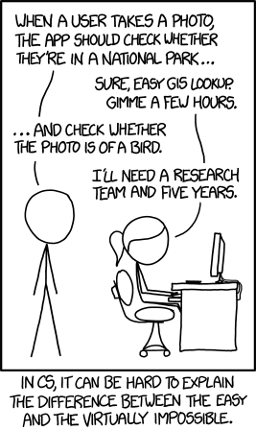
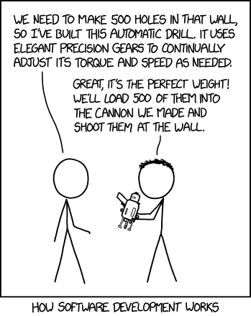
Developing Software
https://xkcd.com/2021/
https://xkcd.com/1425/

Slide 3
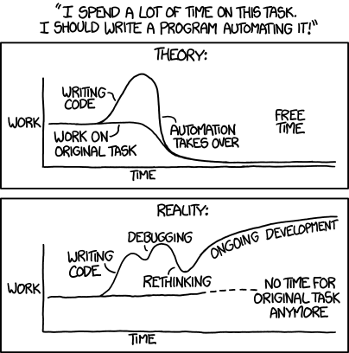
Developing Software
https://xkcd.com/1319/

Slide 4

Developing Software
https://xkcd.com/927/

Slide 5
Developing Software – and papers
my_awesome_file.py
my_awesome_file2.py
my_awesome_fie3.py
my_awesome_file3.py
my_awesome_file_changes.py
my_awesome_file_final.py
my_awesome_file_final_final.py
my_awesome_file_PI_feedback.py
…
Notes:
Many people when writing important papers or software realize the important of being able to go back to a previous version. This is how many people solve the problem – manually creating a new version when they make a large change, are close to a deadline, or get critical feedback from fellow student, instructor, PI, etc.
Just because you haven’t been bit by losing a version of something you are working on doesn’t mean it won’t happen

Slide 6
Version Control Software
“Did you think the lion was sleeping because he didn't roar?” ― Friedrich Schiller, Die Verschwörung des Fiesco zu Genua
Notes:
Luckily there is a better way.
In the process of solving – or creating – problems using software. There will be many times where you or those directing you change their mind. Version control software can help you to recover previous versions, undo mistakes, understand how something was developed, or provide important documentation.
Since the mid 1980’s people have been developing software to help manage their software. The current industry recognized best and open source solution for version control is Git. While I’ll be talking about git, the concepts, techniques and workflow you learn from Git can be applied to other version control software and are an important part of the software development process.

Slide 7

Why Git Rules the world (of software)
https://www.atlassian.com/git/tutorials/why-git
Notes:
Git has branching
Decentralized workflow
Support for multiple people working on the same thing at the same time – though only really works with text files.

Slide 8
Why Git Rules the world
Save Time
Git is lightning fast. And although we're talking about only a few seconds per command, it quickly adds up in your work day. Use your time for something more useful than waiting for your version control system to get back to you.
Work Offline
What if you want to work while you're on the move? With a centralized VCS like Subversion or CVS, you're stranded if you're not connected to the central repository. With Git, almost everything is possible simply on your local machine: make a commit, browse your project's complete history, merge or create branches... Git let's you decide where and when you want to work.
https://www.git-tower.com/learn/git/ebook/en/command-line/appendix/why-git

Slide 9
Why Git Rules the world
Undo Mistakes
People make mistakes. A good thing about Git is that there's a little "undo" command for almost every situation. Correct your last commit because you forgot to include that small change. Revert a whole commit because that feature isn't necessary, anymore. And when the going gets tough you can even restore disappeared commits with the Reflog - because, behind the scenes, Git rarely really deletes something. This is peace of mind.
Don't Worry
Git gives you the confidence that you can't screw things up - and this is a great feeling. In Git, every clone of a project that one of your teammates might have on his local computer is a fully usable backup. Additionally, almost every action in Git only adds data (deleting is very rare). That means that losing data or breaking a repository beyond repair is really hard to do.
https://www.git-tower.com/learn/git/ebook/en/command-line/appendix/why-git

Slide 10
Why Git Rules the world
Don’t Mix Things Up
Separation of concerns is paramount to keeping track of things. While you’re working on feature A, nothing (and no-one) else should be affected by your unfinished code. What if it turns out the feature isn’t necessary anymore? Or if, after 10 commits, you notice that you took a completely wrong approach? Branching is the answer for these problems. And while other version control systems also know branches, Git is the first one to make it work as it should: fast & easy.
https://www.git-tower.com/learn/git/ebook/en/command-line/appendix/why-git

Slide 11
Common Terms
git checkout
git status
git add
git commit
git push
git pull
git branch
git log
Notes:
Explain briefly what each of these do.
Demonstration?

Slide 12
Best Practices Git
Make git part of your workflow. Git integrates with RStudio, Visual Studio Code, and many other common editors
Commit at least daily – preferably anytime you solve a major problem or have done something worth keeping
Push changes immediately after a commit
Write detailed commit messages. Your future self will thank you!
Everything committed can be undone.
Do not commit passwords, Protected Health Information, or other sensitive data
Notes:
Coalary to “Everything committed can be undone” – Code not committed might as well not exist
? Show commit history example.
? Example of multiple people working together

Slide 13
Best Practices Git
When Working with others:
Branching is helpful
Pull before you push
Notes:
Coalary to “Everything committed can be undone” – Code not committed might as well not exist
? Show commit history example.
? Example of multiple people working together

Slide 14

Notes:
While Git is open source, there are many websites that offer git hosting along with additional functionality.
Github is very common. Other options include BitBucket, GitLab, and more.
Clicking sign in takes you to your browser to use/setup a github.com account

Slide 15
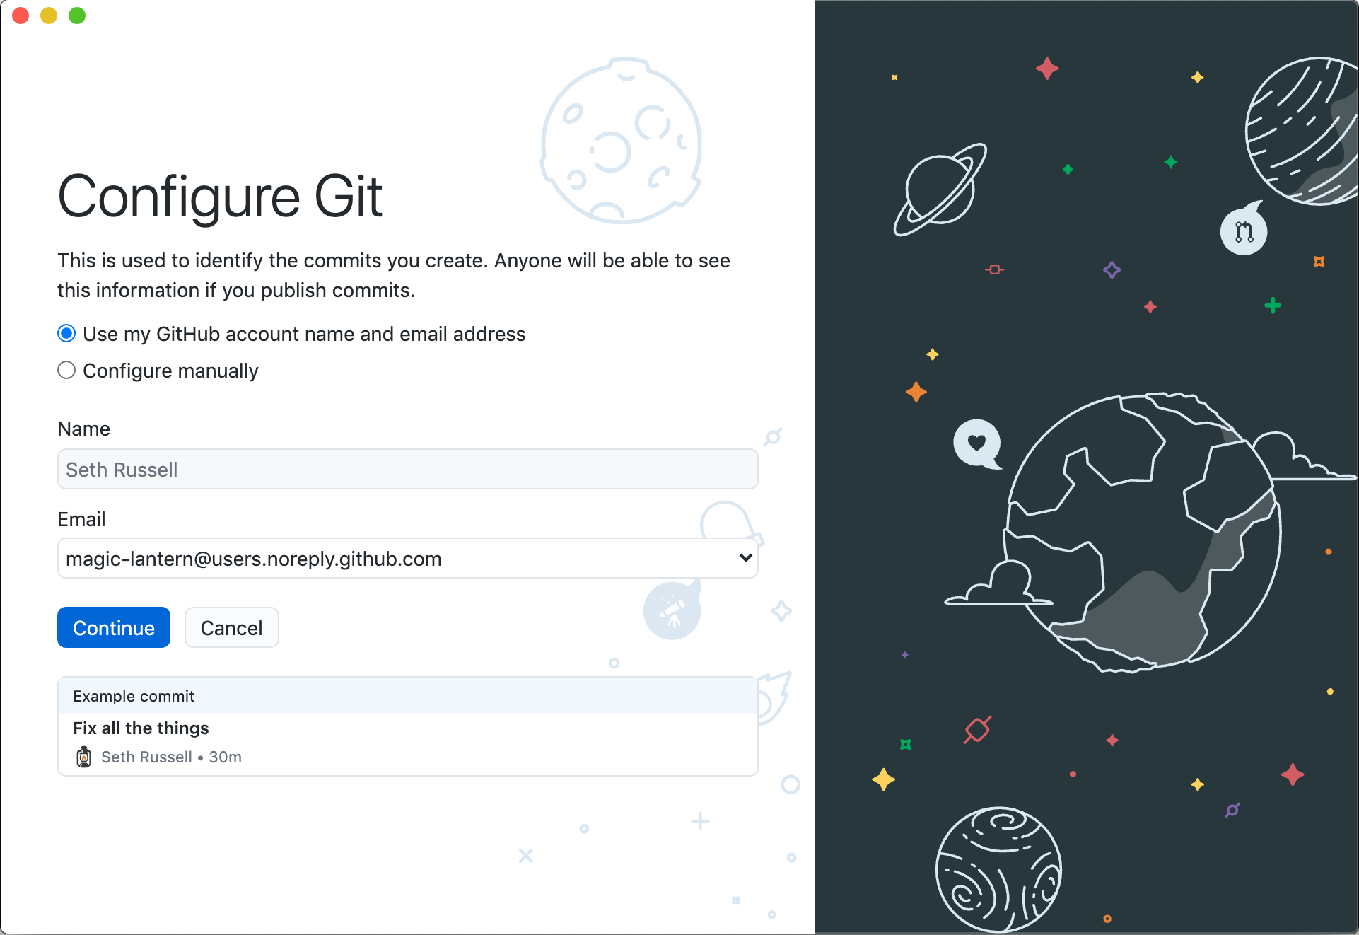
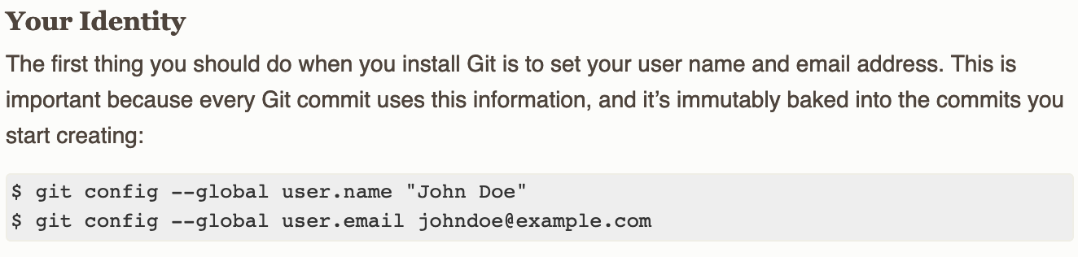

Slide 16

Notes:
While Git is open source, there are many websites that offer git hosting along with additional functionality.
Github is very common. Other options include BitBucket, GitLab, and more.
Clicking sign in takes you to your browser to use/setup a github.com account

Slide 17
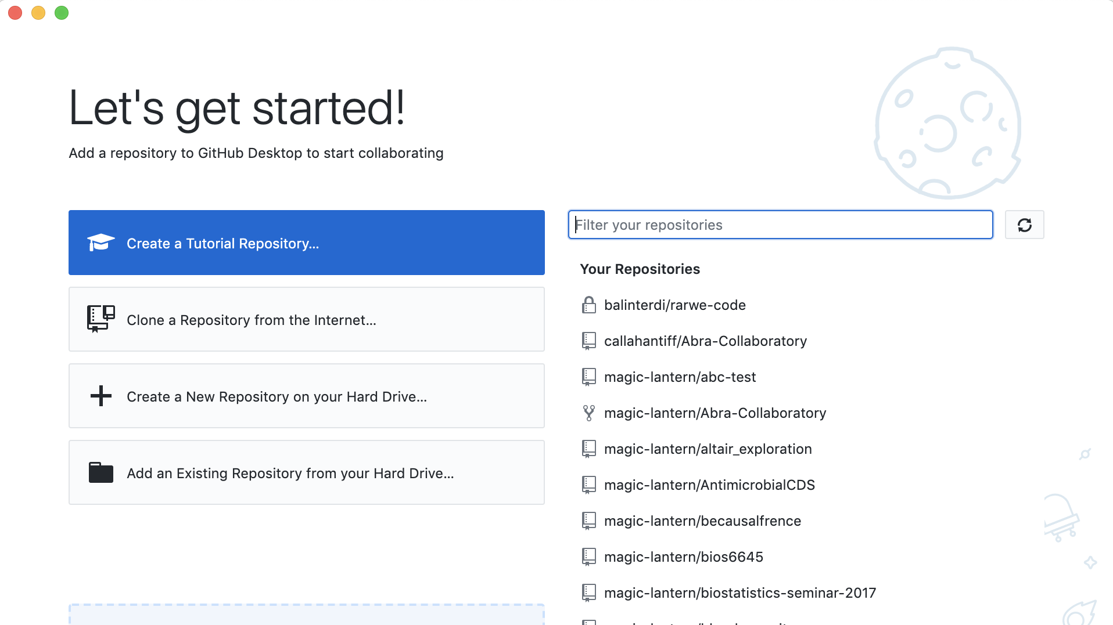

Slide 18
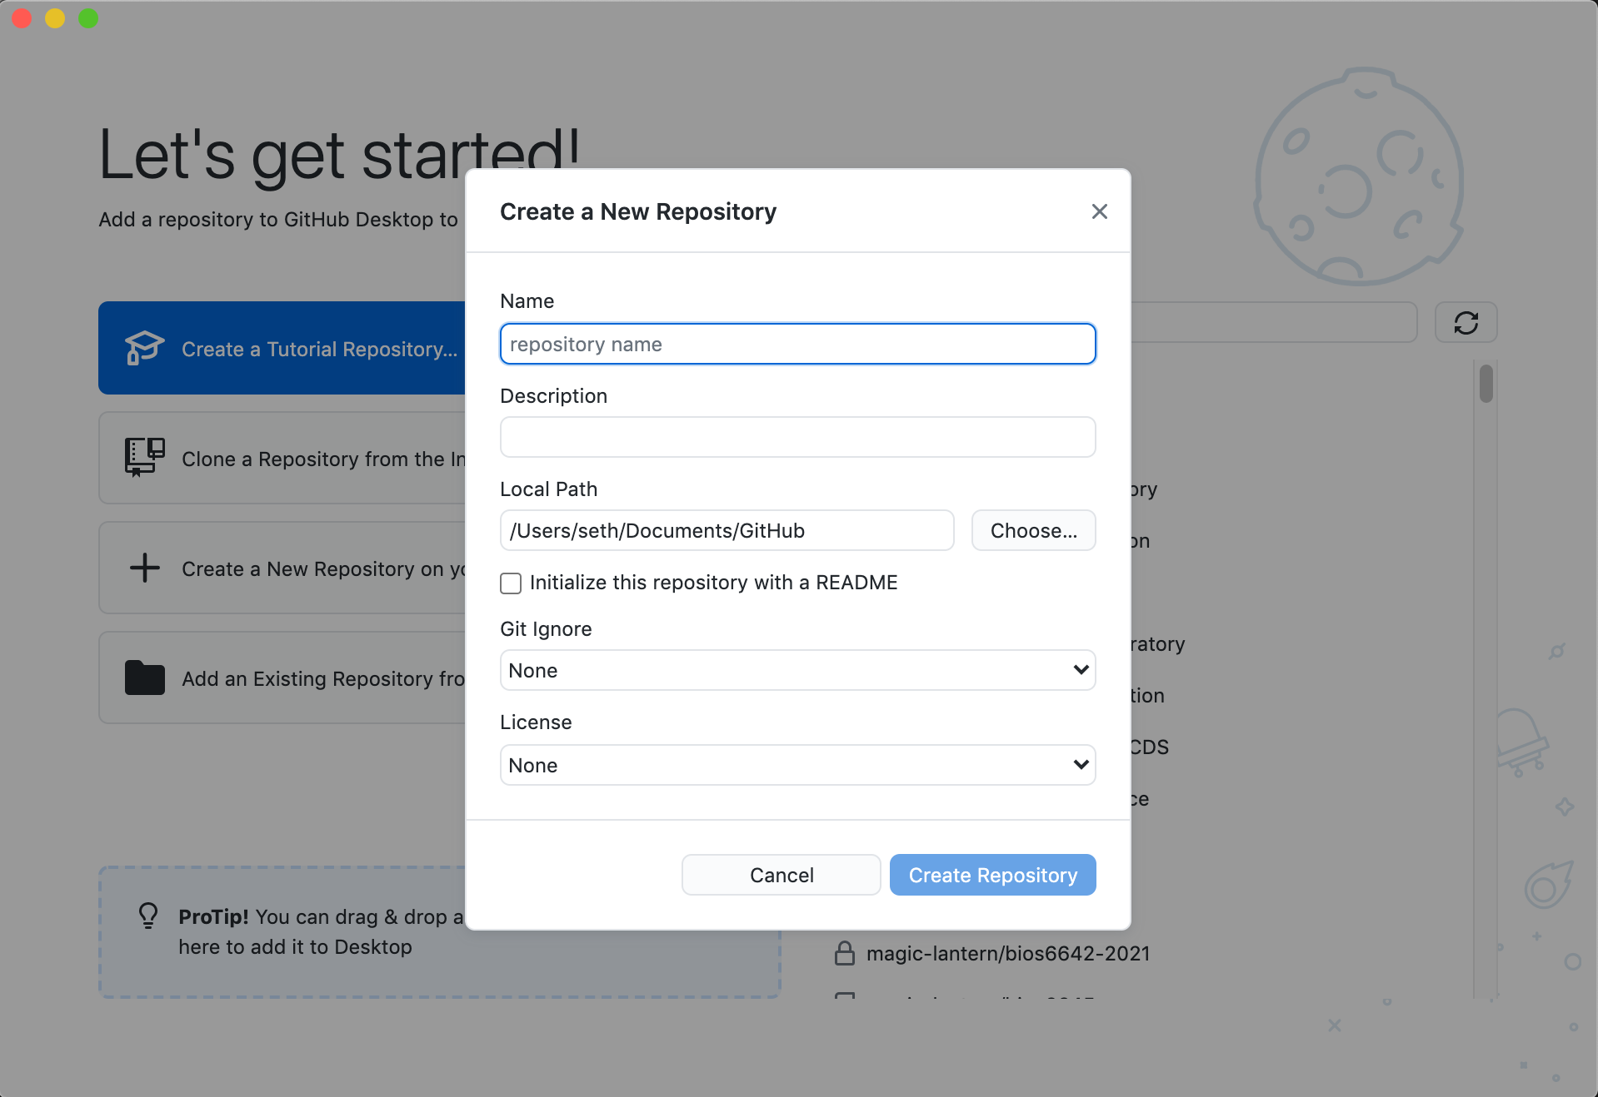

Slide 19
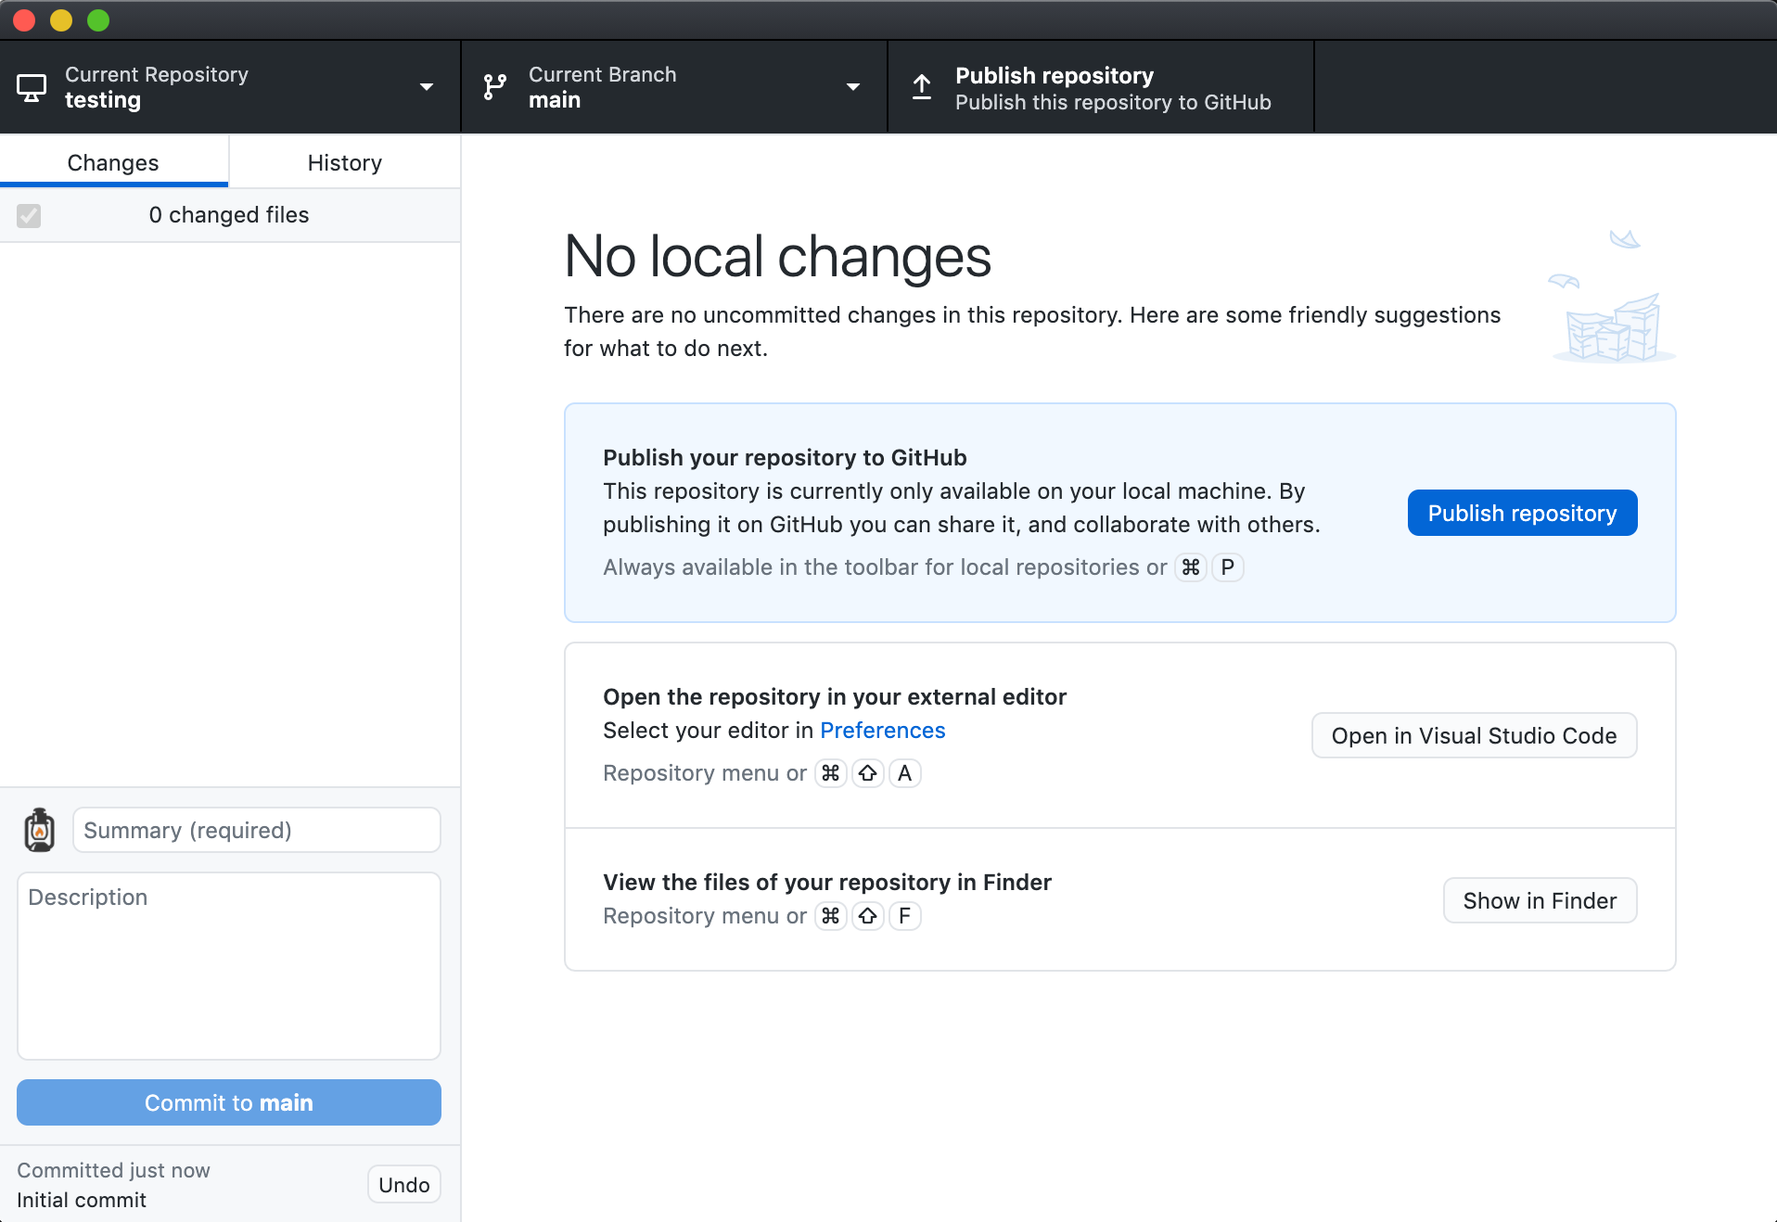
Notes:
While Git is open source, there are many websites that offer git hosting along with additional functionality.
Github is very common. Other options include BitBucket, GitLab, and more.
Clicking sign in takes you to your browser to use/setup a github.com account

Slide 20
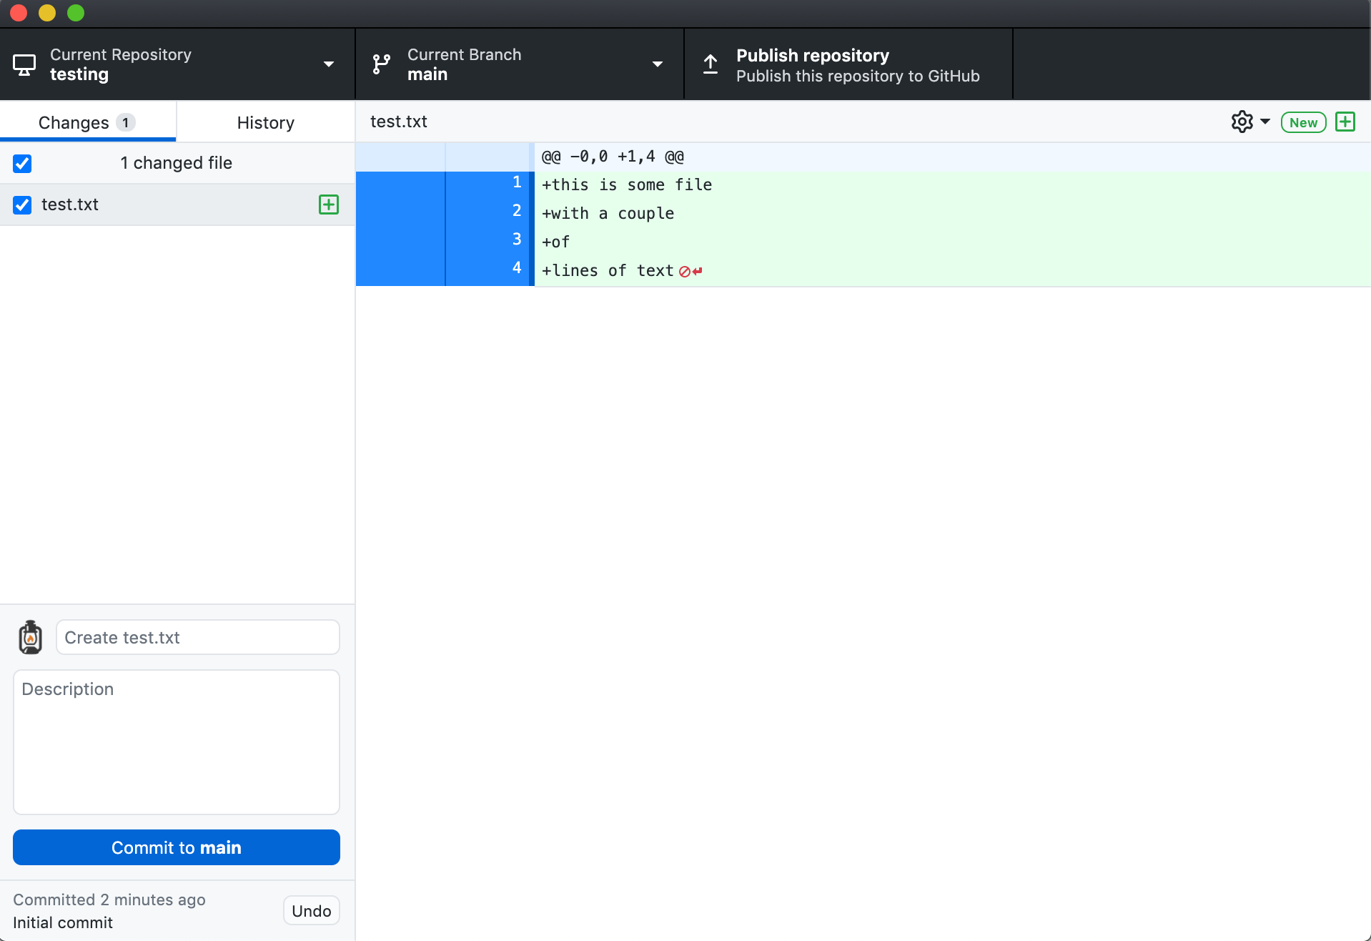

Slide 21
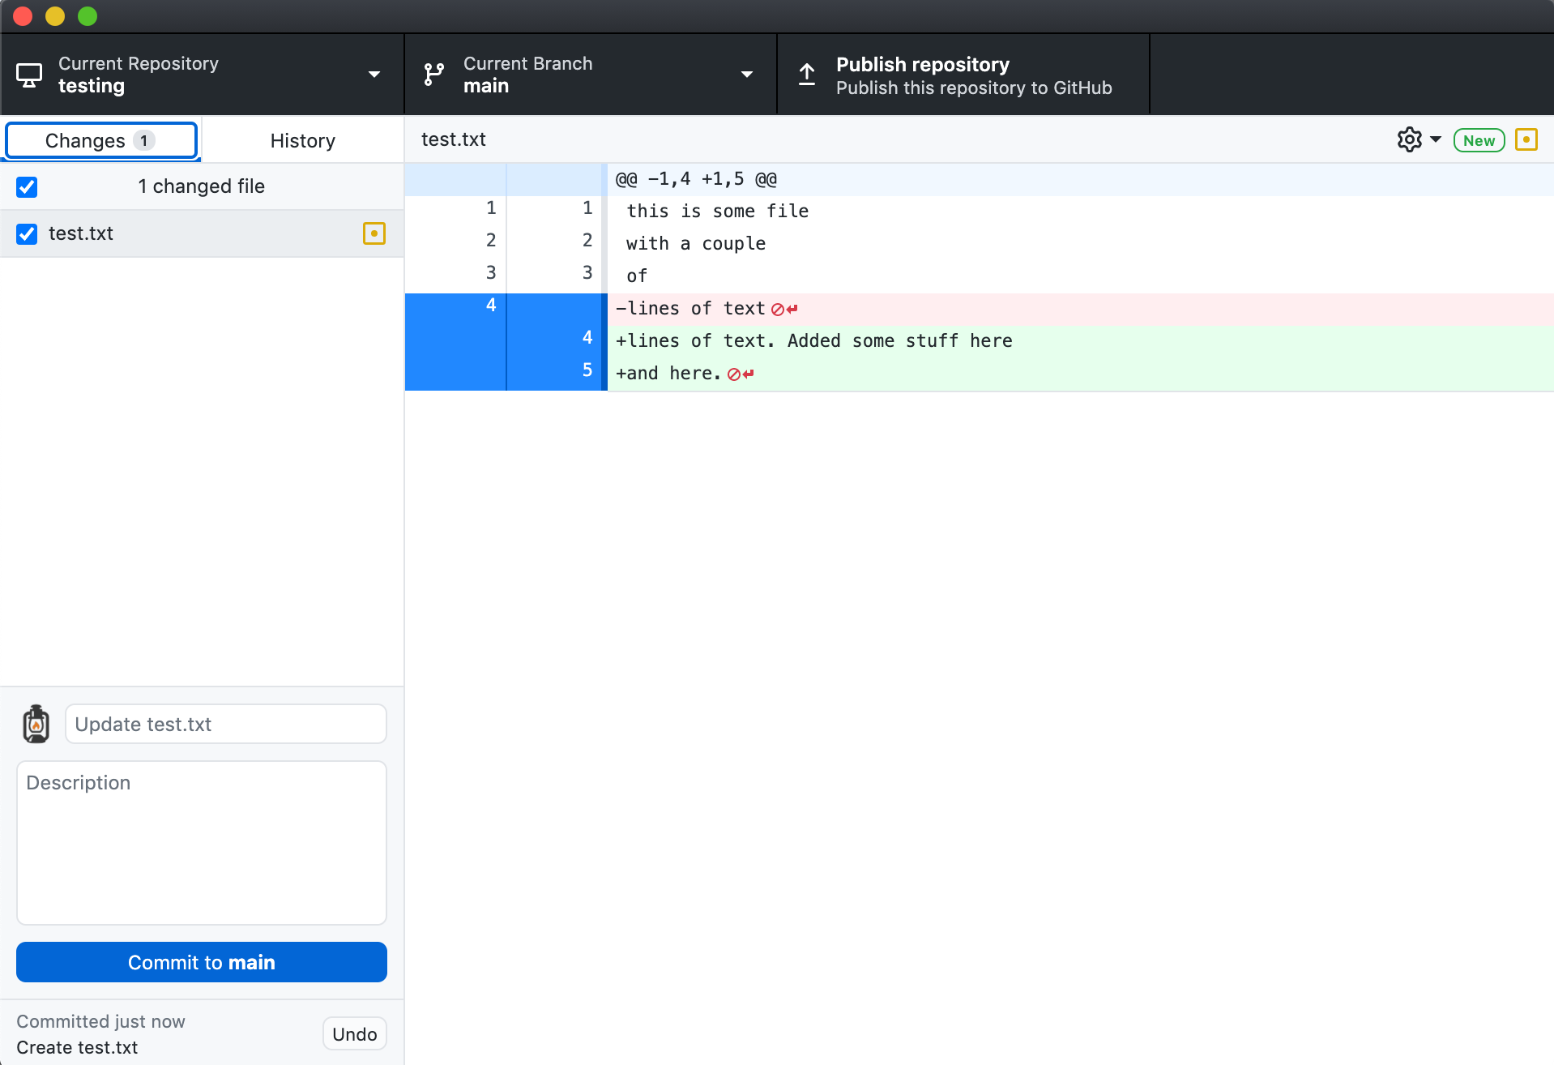

Slide 22
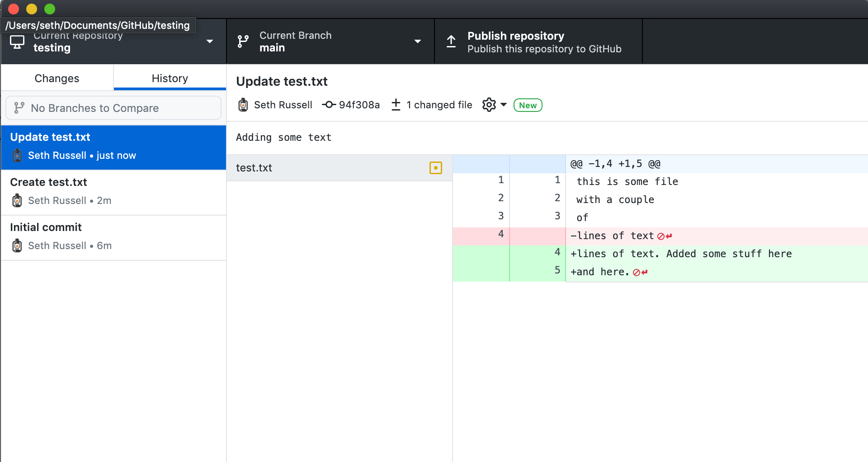

Slide 23
Version Control
What deep wounds ever closed without a scar?
Lord Byron
Notes:
Best way to learn git is by using it – or not using it and losing work and thus realizing you need to make an improvement in this area.

Slide 24
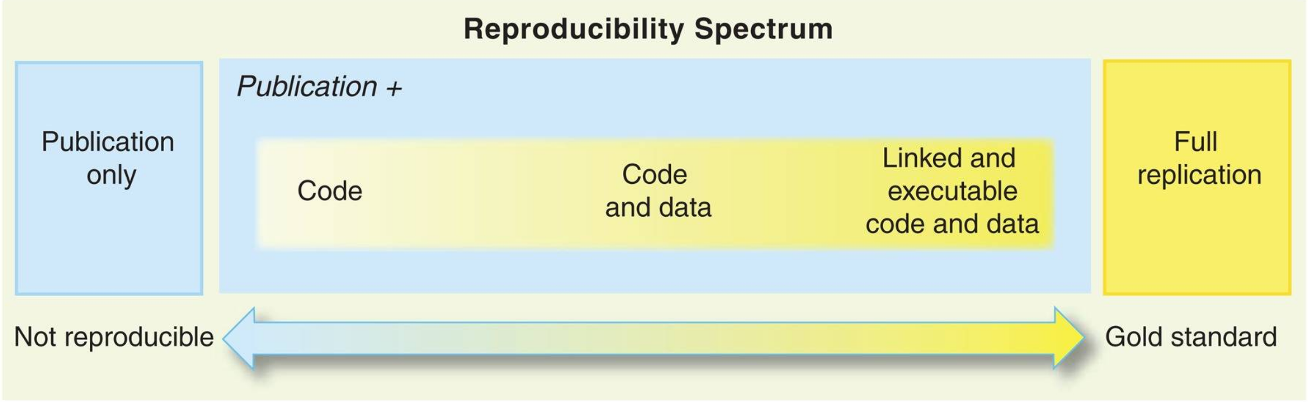
Git and Reproducible Science
Peng RD. Reproducible research in computational science. Science. 2011 Dec 2;334(6060):1226-7. doi: 10.1126/science.1213847. PMID: 22144613; PMCID: PMC3383002.
Notes:
Key Points
Open scientific work is more useful and more highly cited than closed.
Making Code Citable
Anything that is hosted in a version control repository (data, code, papers, etc.) can be turned into a citable object. You’ll learn how to do this in lesson 12: Citation.
How Reproducible Is My Work?
Ask one of your labmates to reproduce a result you recently obtained using only what they can find in your papers or on the web. Try to do the same for one of their results, then try to do it for a result from a lab you work with.
How to Find an Appropriate Data Repository?
Surf the internet for a couple of minutes and check out the data repositories mentioned above: Figshare, Zenodo, Dryad. Depending on your field of research, you might find community-recognized repositories that are well-known in your field. See also “Recommended Data Repositories“ from Nature.
How to Track Large Data or Image Files using Git?
Large data or image files such as .md5 or .psd file types can be tracked within a github repository using the Git Large File Storage open source extension tool. This tool automatically uploads large file contents to a remote server and replaces the file with a text pointer within the github repository.

